Slide 1

Department of Computer Science And Engineering
Course Name: Project With Design Thinking (Product / Software Development Life Cycle)
Title of the project : RESQTAIL
15-04-2025
1

Slide 2

Class / Section / Semester Batch Project Review Date Project Guide with Designation Name of the Industry ( if applicable)
: : :
II / CSE B / IV 2023 - 2027 Second Review
: 15/04/2025
:
:
Ms.J.Keerthika AP/CSE
-
NAVEEN PRASANTH P
NIGUN KARTHI R
SANTHOSH SIVA S
Team Members
:
15-04-2025
2

Slide 3
CHALLENGE STATEMENT
Lack of Immediate SOS Mechanism
Domestic animals have no direct way to signal distress or emergencies without human observation.
Lack of User-Friendly Interfaces
Many current applications are not intuitive, making it hard for users to monitor and respond quickly in emergency scenarios.
Insufficient Testing in Real-Life Conditions
Most systems aren’t field-tested under real scenarios like pet distress, extreme weather, or night conditions, leading to reliability concerns.
Dependency on Human Input
Existing solutions often require a human to notice and act, which delays response time and defeats the purpose of automated SOS.
15-04-2025
3

Slide 4
CONCEPT / SCOPE OF SOLUTION
Concept:
ResQtail is a software-based emergency response system designed to assist domestic animals in distress. It functions through a mobile application that uses behavioral data input, GPS tracking, and customizable alert features to notify pet owners, shelters, or rescue volunteers during emergencies.
Scope of Solution:
Mobile Application: A user-friendly app that tracks and monitors pets using smartphone sensors and inputs.
Emergency Alert System: Triggers alerts based on predefined conditions (e.g., prolonged inactivity, separation from owner).
Real-Time GPS Tracking: Uses mobile device location to monitor animal whereabouts and detect movement anomalies.
15-04-2025
4

Slide 5
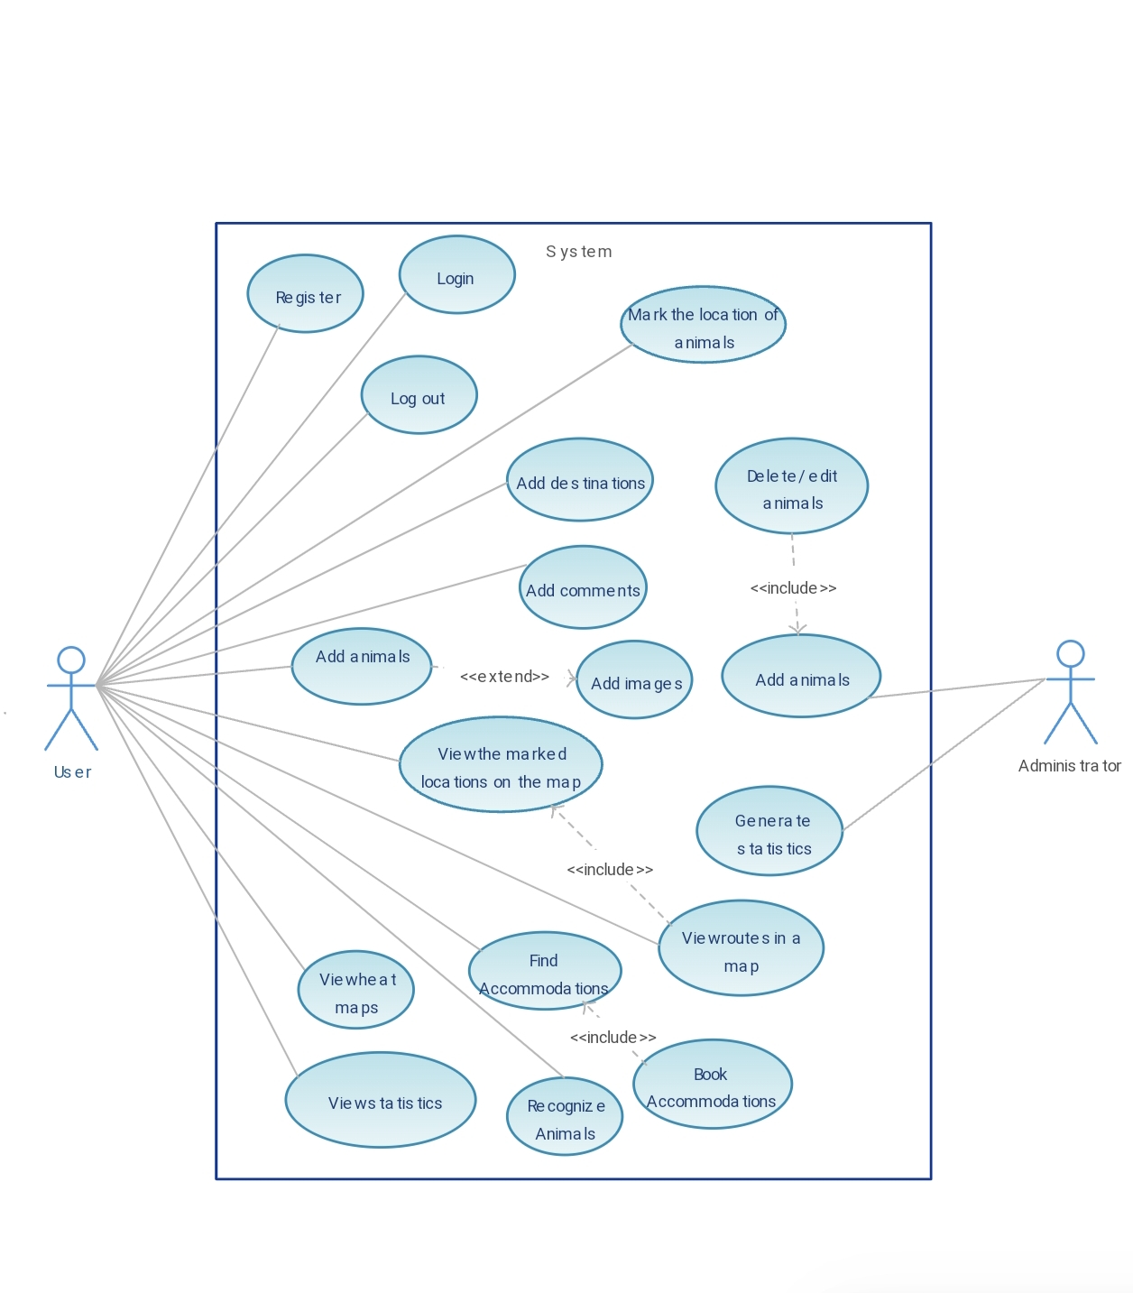
USECASE DIAGRAM

Slide 6

S.No
1.
2.
3.
LITERATURE SURVEY / BACKGROUND STUDY
NAME OF ORGANIZATION &YEAR
TITLE
AUTHOR
DESCRIPTION
A pet recovery platform that connects pet owners with a community to report lost pets. Relies on manual inputs from users, not automated.
PawBoost: Lost Pet
Alerts
Team PawBoosts
PawBoost,
2014
Uses facial recognition technology to match lost pets with found pets. Lacks real-time emergency alerts.
Finding Rover: Lost Pet Finder
Team Finding Rover
Finding Rover Inc.,
2016
Explores the use of behavioral data to predict and detect emergency situations for pets. Focuses on AI but lacks a user-friendly interface or app integration.
Behavioral Analysis of Pets for Emergency Response
Liu, S., & Zhang, L.
Zhejiang University, 2018
15-04-2025
5

Slide 7



EXISTING METHOD
Manual Reporting Systems
User report emergencies to rescue teams.
Example: Petco Foundation offers a hotline for reporting lost or injured pets.
Animal Welfare Hotlines
Provides immediate advice and emergency response.
Example: ASPCA’s Animal Poison Control provides 24/7 support for emergencies.
GPS Pet Trackers
Tracks pets in real-time via GPS.
Example: Pet Amber Alert uses social media and email to spread missing pet information.
15-04-2025
6

Slide 8
PROPOSED / INNOVATIVE METHOD
1. Automated Emergency Detection
ResQtail uses behavior-based on automatically detect emergencies based on pet activity, ensuring faster response without requiring user input.
2. Real-Time Alerts & GPS Location
When an emergency is detected, the system immediately sends real-time alerts with GPS coordinates, enabling quick action from pet owners or rescue teams.
3. Accessible & Cost-Effective Solution
Utilizing Web application and smartphone and a simple, ResQtail provides an affordable, hardware-free system that is easy to use and accessible to a wide audience.
15-04-2025
7

Slide 9
SPECIFICATION
S.No
SOFTWARE SPECIFICATIONS
1
Operating System Compatibility
2
Location-Based Services
3
Behavior Detection & Alert System
15-04-2025
8

Slide 10
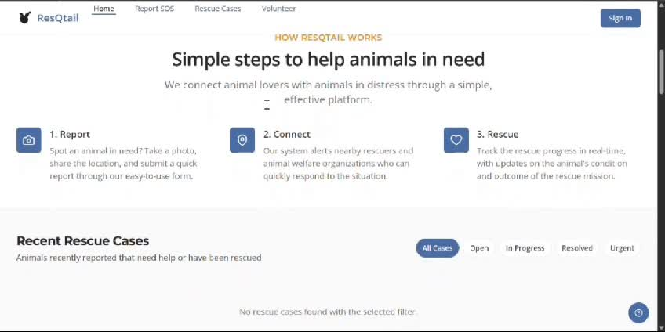
OUTPUT VIDEO
15-04-2025
9

Slide 11
CONCLUSION
ResQtail aims to revolutionize pet safety by providing a software-based, intelligent rescue system that detects emergencies in real-time using behavioral patterns and location tracking.By eliminating the need for expensive hardware and relying on accessible mobile technology, ResQtail offers a cost-effective, efficient, and scalable solution for pet owners and rescue networks.This project not only enhances domestic animal welfare but also fills critical gaps in existing rescue systems through automation, AI integration, and real-time responsiveness.
15-04-2025
10

Slide 12

PENDING WORK
DESCRIPTION
EXPECTED DUE DATE
REASON FOR PENDING
Requirement Analysis
February 2025
Completed
System design & AI Chatbot
February 2025
Completed
Integration of GPS tracking & live location
March 2025
Completed
Testing, debugging & security enhancements
April 2025
-
Final deployment & user trials
May 2025
-
15-04-2025
11

Slide 13
Reference
Stray Animal Welfare and Rescue Operations: A Global Perspective https://www.ncbi.nlm.nih.gov/pmc/articles/PMC7361320
Community-Driven Animal Rescue via Digital Platforms https://doi.org/10.3390/info12040134
Google Maps Platform (Maps + Geolocation APIs) https://developers.google.com/maps

Slide 14
THANK YOU
15-04-2025
12

